Slide 1
AI

Slide 2
Artificial Intelligence
8.1.3 Agent-based view of AI (Ch. 2)

Slide 3
Outline
Agents and environments
Rationality
PEAS (Performance measure, Environment, Actuators, Sensors)
Environment types
Agent types

Slide 4
Agents
An agent is anything that can be viewed as perceiving its environment through sensors and acting upon that environment through actuators
Human agent: eyes, ears, and other organs for sensors; hands, legs, mouth, and other body parts for actuators
Robotic agent: cameras and infrared range finders for sensors; various motors for actuators

Slide 5
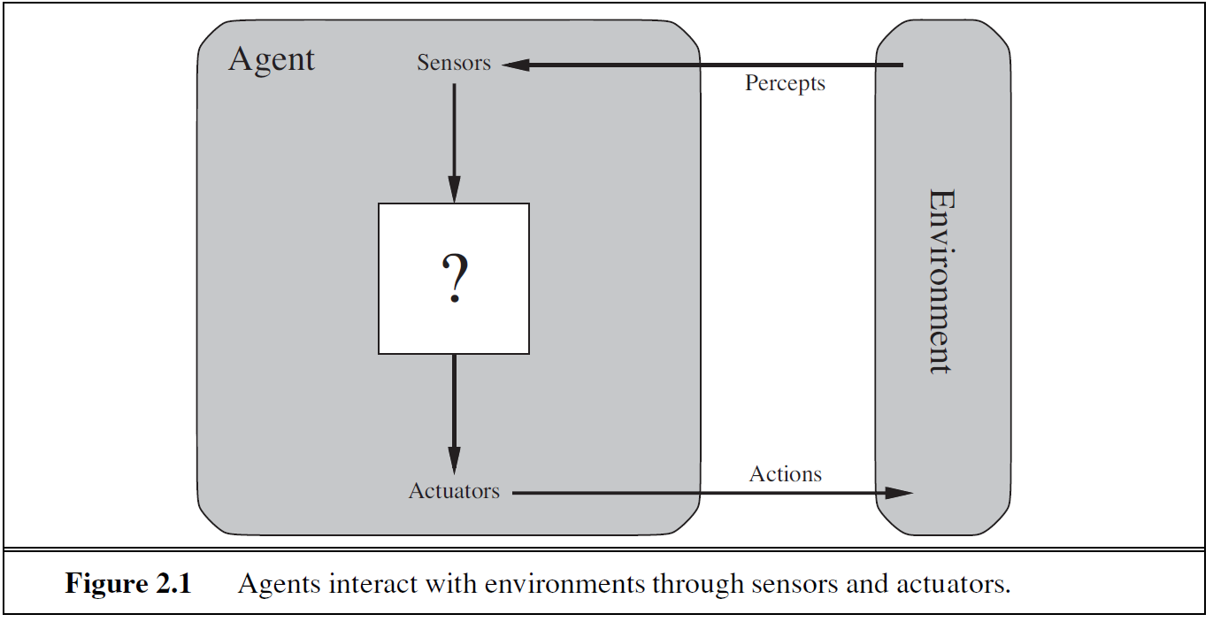
Agents and environments
The agent function maps from percept histories to actions:
[f: P* → A]
The agent program runs on the physical architecture to produce f agent = architecture + program

Slide 6
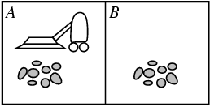
Vacuum-cleaner world
Percepts: location and contents, e.g., [A,Dirty] Actions: Left, Right, Suck, NoOp

Slide 7
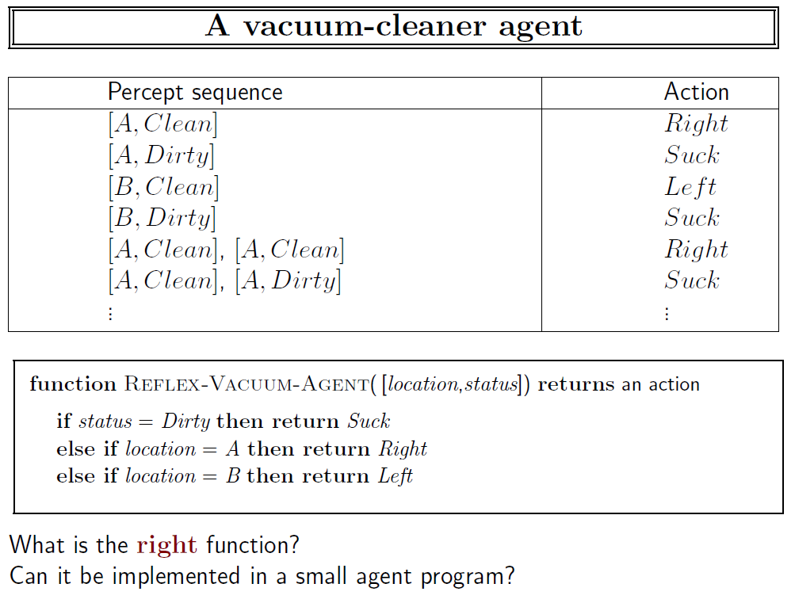

Slide 8
Rational agents
An agent should strive to "do the right thing", based on what it can perceive and the actions it can perform. The right action is the one that will cause the agent to be most successful
Performance measure: An objective criterion for success of an agent's behavior
E.g., performance measure of a vacuum-cleaner agent could be amount of dirt cleaned up, amount of time taken, amount of electricity consumed, amount of noise generated, etc.

Slide 9
Rational agents
Rational Agent: For each possible percept sequence, a rational agent should select an action that is expected to maximize its performance measure, given the evidence provided by the percept sequence and whatever built-in knowledge the agent has.

Slide 10
Rational agents
Rationality is distinct from omniscience (all-knowing with infinite knowledge)
Agents can perform actions in order to modify future percepts so as to obtain useful information (information gathering, exploration)
An agent is autonomous if its behavior is determined by its own experience (with ability to learn and adapt)

Slide 11
PEAS
PEAS
Performance measure, Environment, Actuators, Sensors
Must first specify the setting for intelligent agent design Consider, e.g., the task of designing an automated taxi driver:
Performance measure:
Safe, fast, legal, comfortable trip, maximize profits
Environment:
Roads, other traffic, pedestrians, customers
Actuators:
Steering wheel, accelerator, brake, signal, horn
Sensors:
Cameras, sonar, speedometer, GPS, odometer, engine sensors, keyboars

Slide 12
PEAS
Agent: Medical diagnosis system
Performance measure:
Healthy patient, minimize costs, lawsuits
Environment:
Patient, hospital, staff
Actuators:
Screen display (questions, tests, diagnoses, treatments, referrals
Sensors:
Keyboard (entry of symptoms, findings, patient's answers)

Slide 13
PEAS
Agent: Part-picking robot
Performance measure:
Percentage of parts in correct bins
Environment:
Conveyor belt with parts, bins
Actuators:
Jointed arm and hand
Sensors:
Camera, joint angle sensors

Slide 14
PEAS
Agent: Interactive English tutor
Performance measure:
Maximize student's score on test
Environment:
Set of students
Actuators:
Screen display (exercises, suggestions, corrections)
Sensors:
Keyboard

Slide 15
PEAS
Agent: [let’s think of another one]
Performance measure:
Environment:
Actuators:
Sensors:

Slide 16
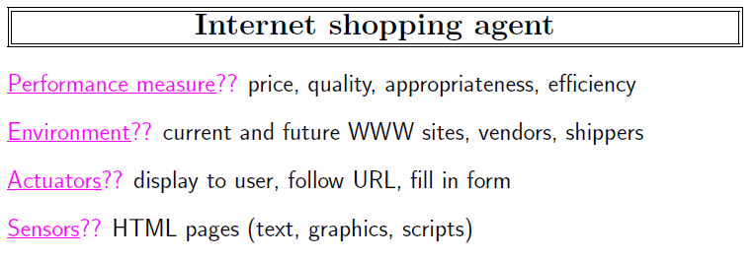

Slide 17
Environment types
Fully observable (vs. partially observable): An agent's sensors give it access to the complete state of the environment at each point in time.
Deterministic (vs. stochastic): The next state of the environment is completely determined by the current state and the action executed by the agent. (If the environment is deterministic except for the actions of other agents, then the environment is strategic)
Episodic (vs. sequential): The agent's experience is divided into atomic "episodes" (each episode consists of the agent perceiving and then performing a single action), and the choice of action in each episode depends only on the episode itself.

Slide 18
Environment types
Static (vs. dynamic): The environment is unchanged while an agent is deliberating. (The environment is semidynamic if the environment itself does not change with the passage of time but the agent's performance score does)
Discrete (vs. continuous): A limited number of distinct, clearly defined percepts and actions.
Single agent (vs. multiagent): An agent operating by itself in an environment.

Slide 19
Environment types
Chess with Chess without Taxi driving
a clock a clock
Fully observable
Deterministic
Episodic
Static
Discrete
Single agent

Slide 20
Environment types
Chess with a clock Chess without a clock Taxi driving
Fully observable Yes Yes No
Deterministic Strategic Strategic No
Episodic No No No
Static Semidynamic Yes No
Discrete Yes Yes No
Single agent No No No
The environment type largely determines the agent design The real world is (of course) partially observable, stochastic, sequential, dynamic, continuous, multi-agent

Slide 21
Agent functions and programs
An agent is completely specified by the agent function mapping percept sequences to actions
One agent function (or a small equivalence class) is rational
Aim: find a way to implement the rational agent function concisely

Slide 22
Table-lookup agent
Drawbacks:
Huge table
Take a long time to build the table
No autonomy
Even with learning, need a long time to learn the table entries

Slide 23
Agent types
Four basic types in order of increasing generality:
Simple reflex agents
Model-based reflex agents
Goal-based agents
Utility-based agents
All can be turned into learning agents

Slide 24
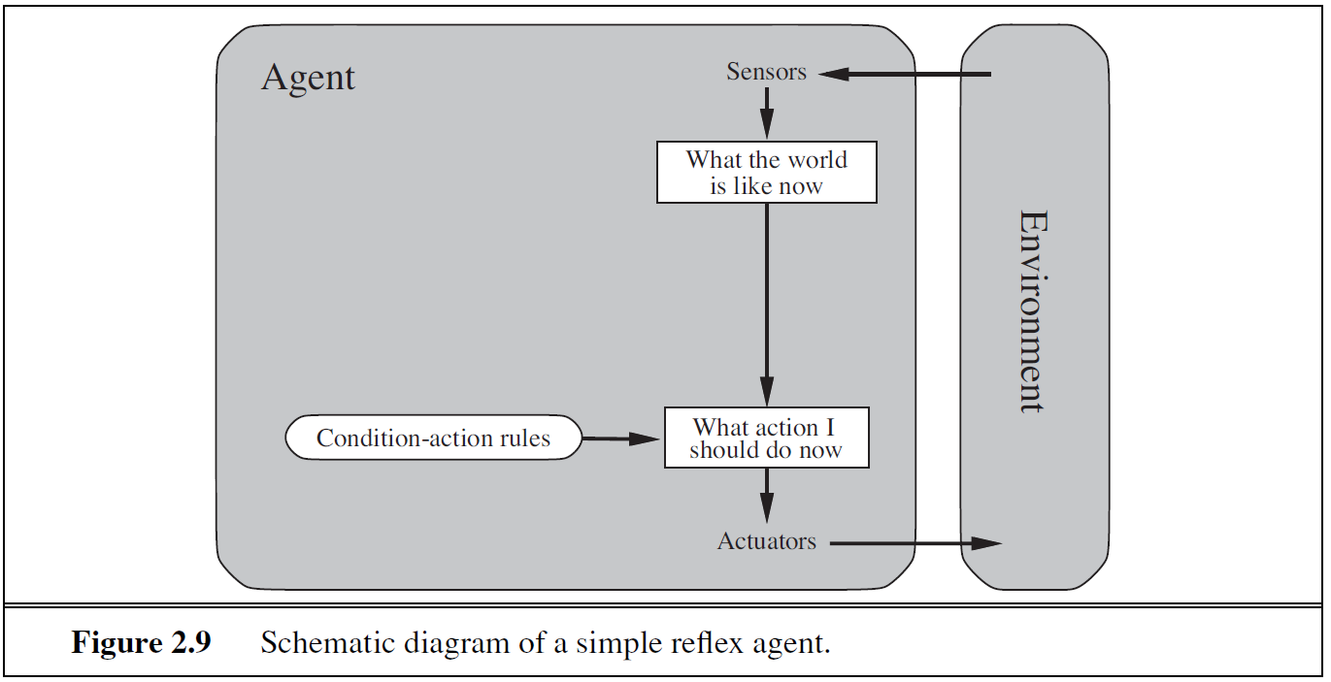
Simple reflex agents

Slide 25
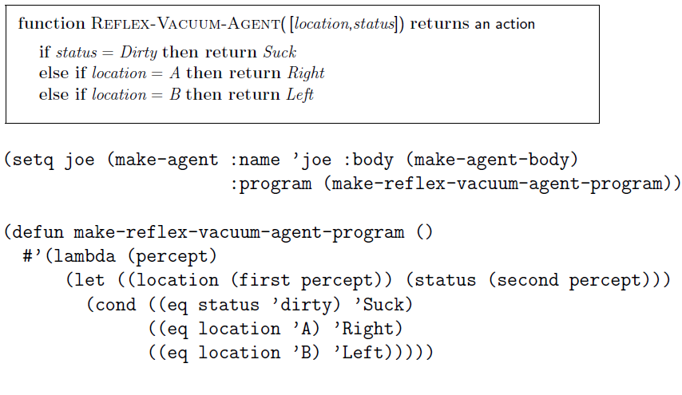

Slide 26
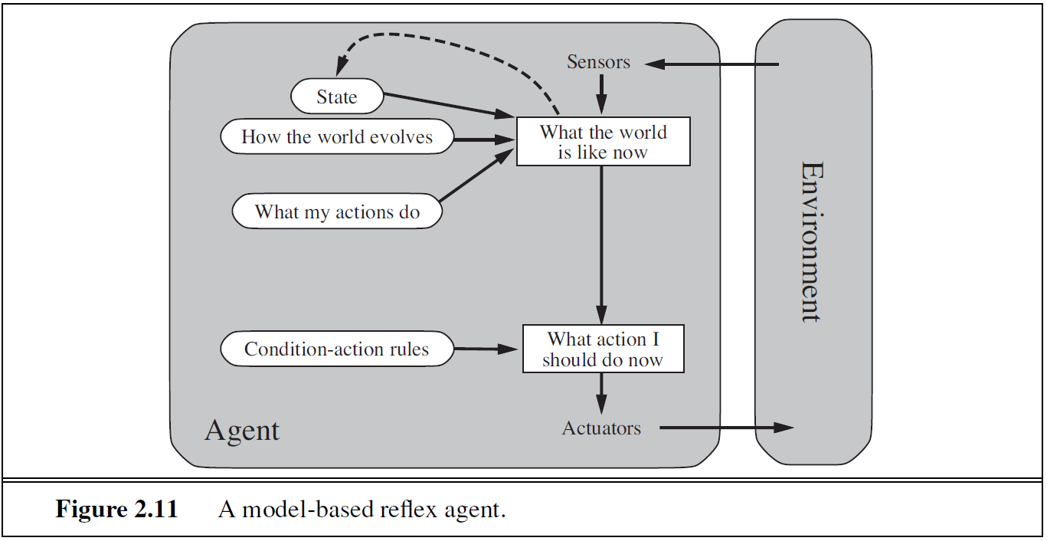
Model-based reflex agents

Slide 27
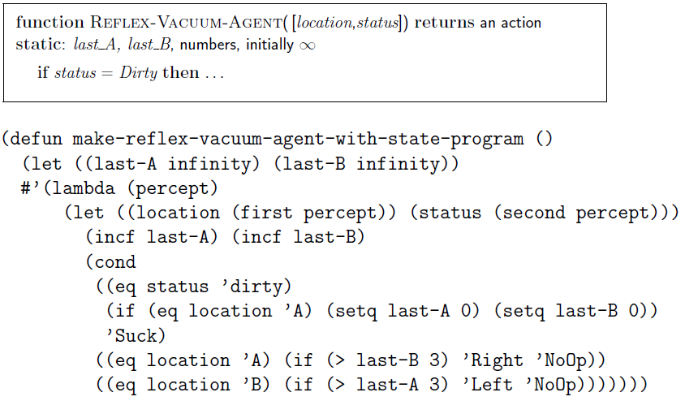

Slide 28
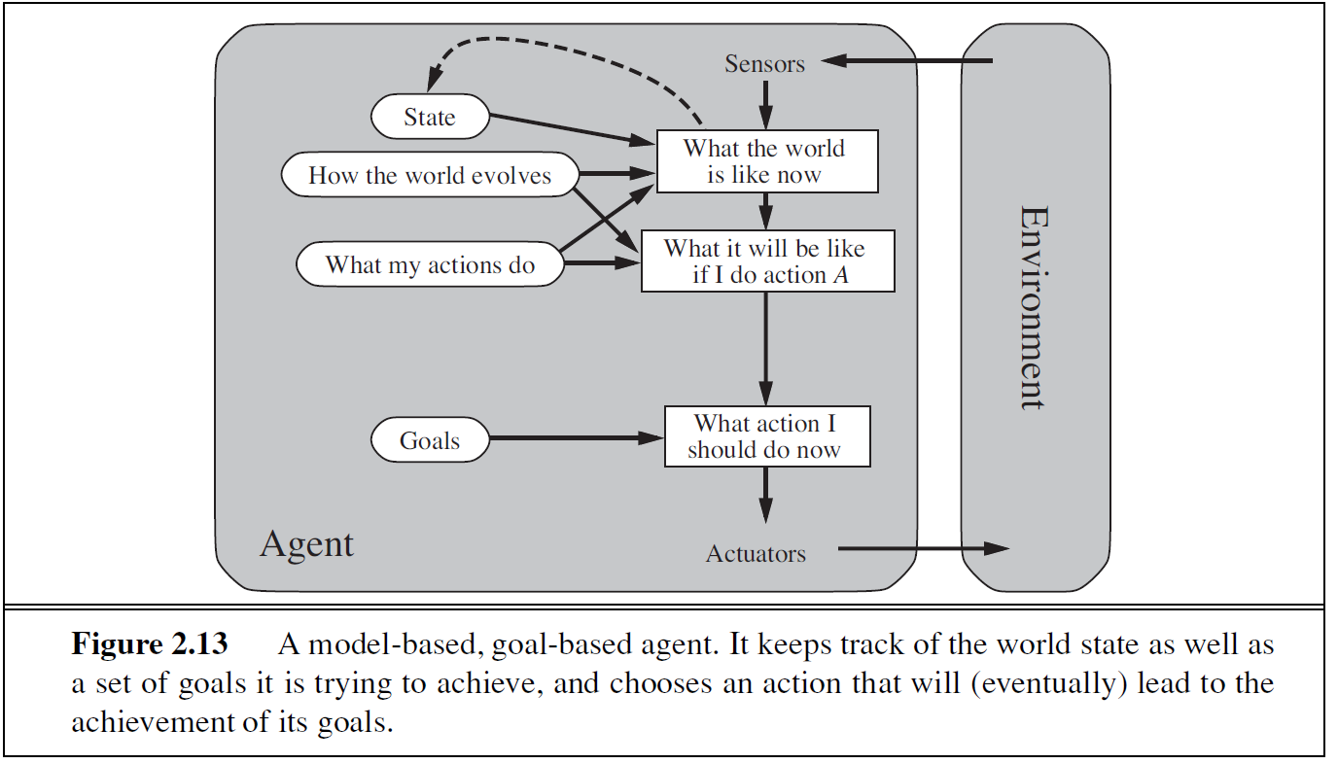
Goal-based agents

Slide 29
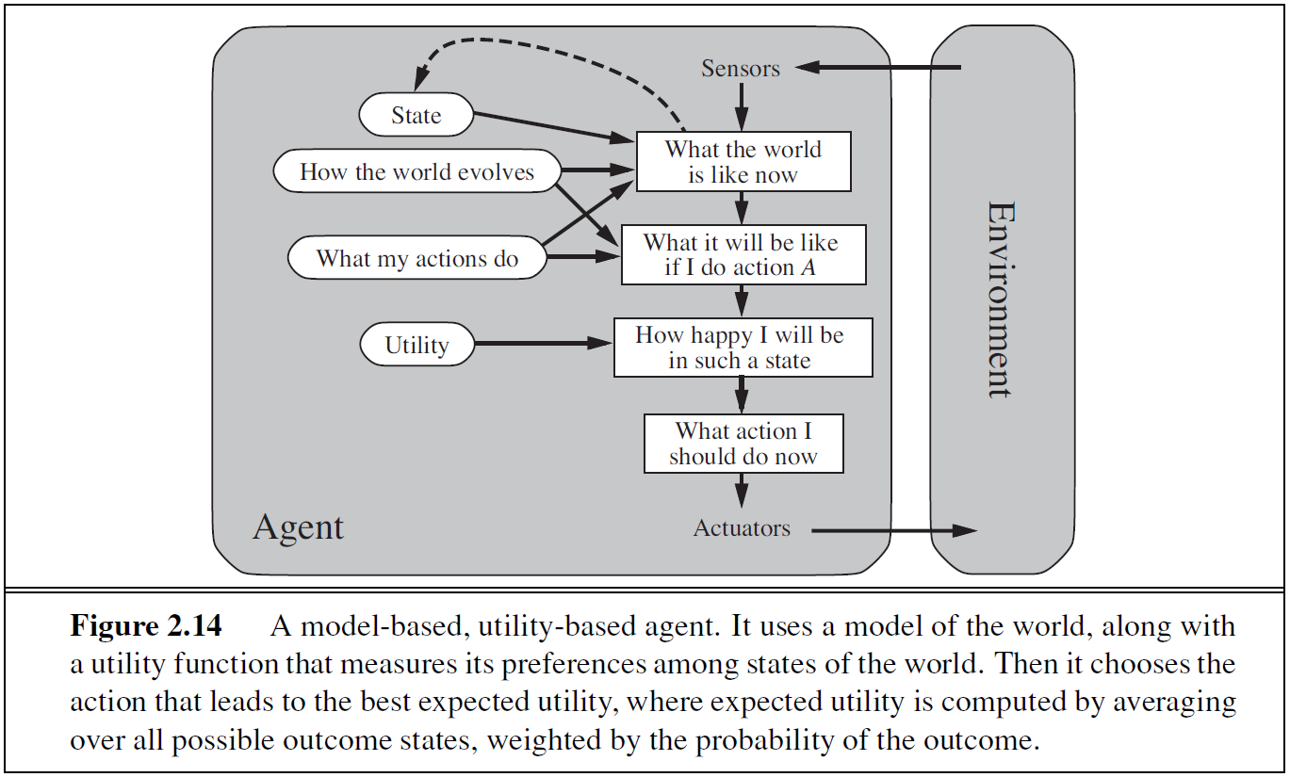
Utility-based agents

Slide 30
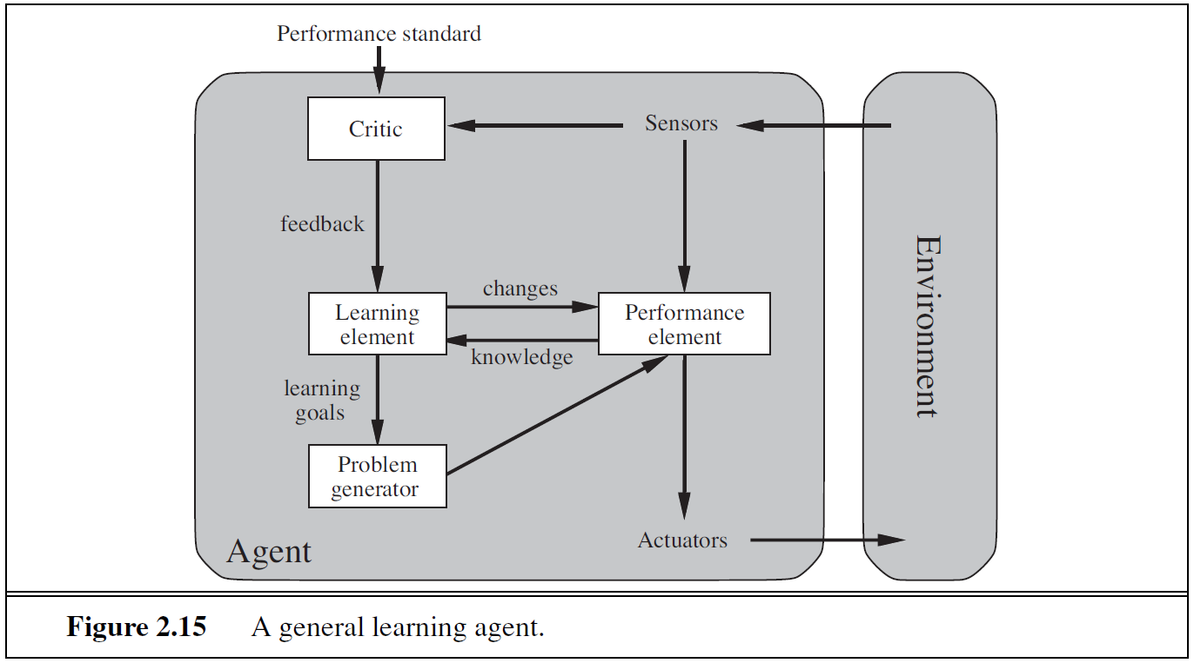
Learning agents

Slide 31
Summary

Slide 32
AI

